Slide 1
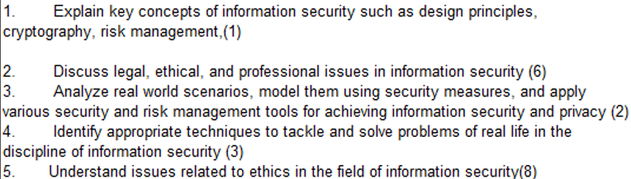
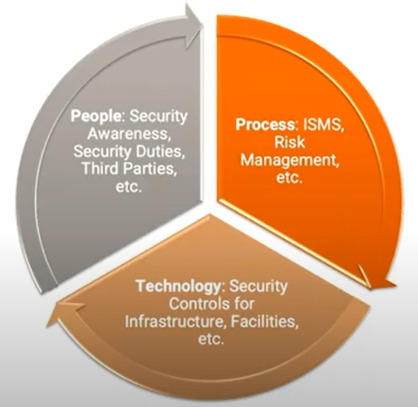
CS 3002 Information Security
Fall 2023
Week # 4 – Lecture # 10, 11,12
Dr. Aqsa Aslam

Slide 2
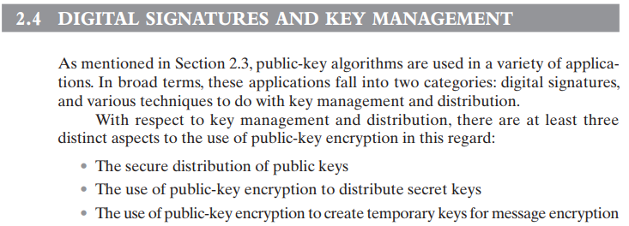

Slide 3
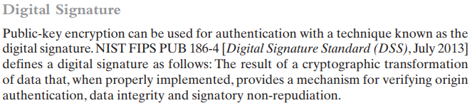
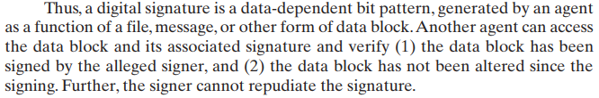

Slide 4
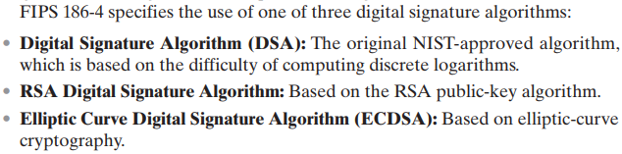

Slide 5
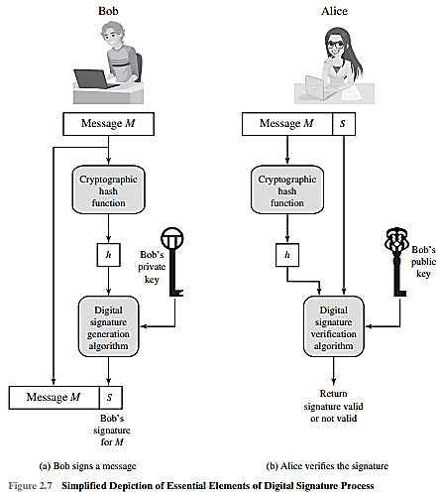

Slide 6
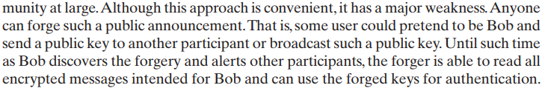
of the public key.

Slide 7
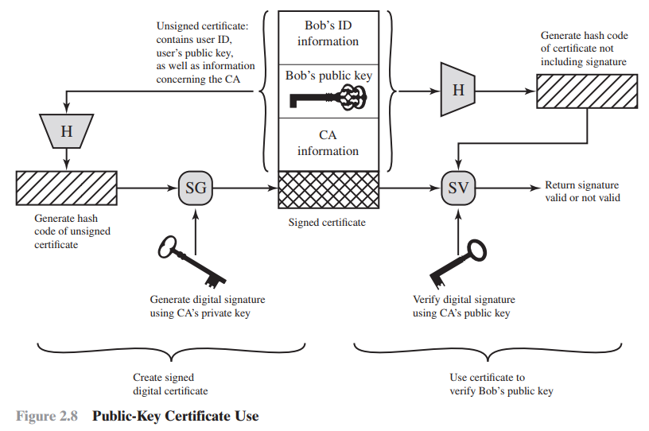

Slide 8
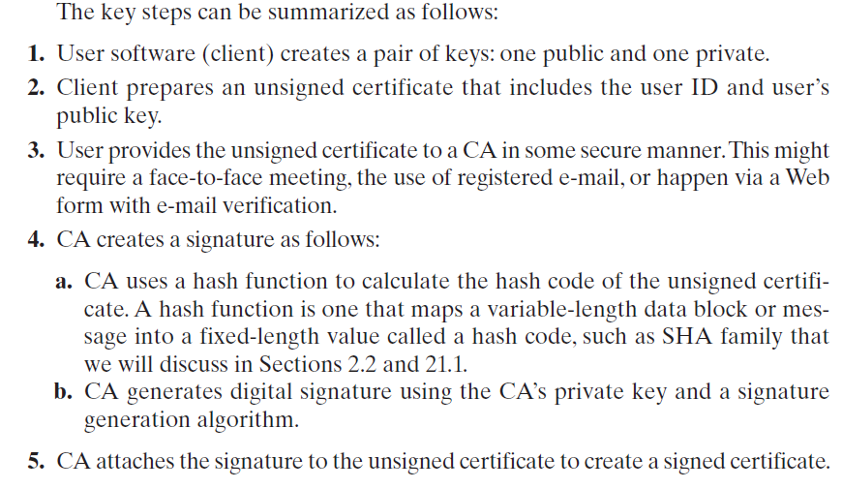
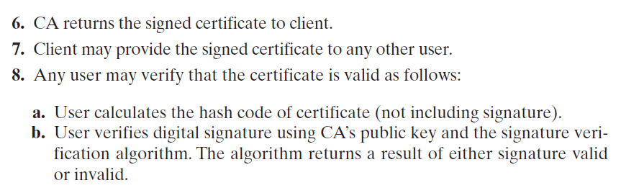
Public-Key Certificates

Slide 9
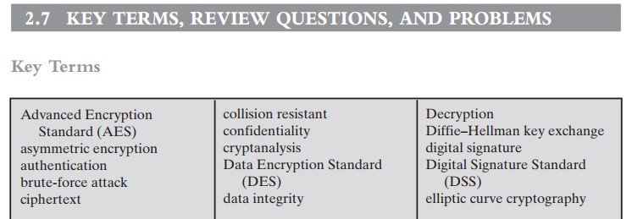
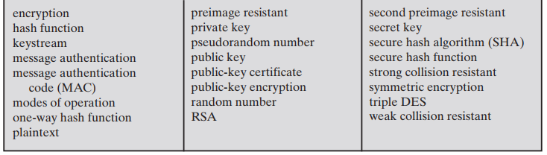

Slide 10
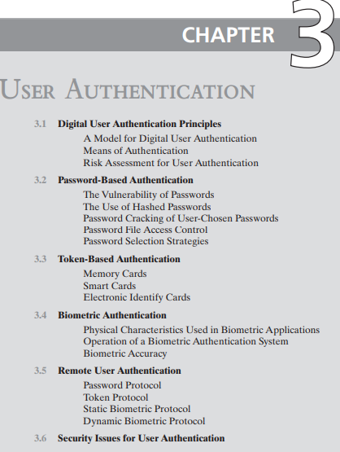
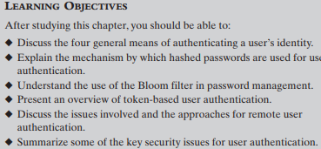

Slide 11
User Authentication
User authentication is a fundamental security building block
User authentication is the basis for:
Access control and User accountability
User authentication encompasses two functions
Identification:
The user identifies herself to the system by presenting a credential
such as user ID.
Verification:
The system verifies the user by the exchange of authentication information.
User Authentication is distinct from message authentication
(when communicating parties are concerned with the integrity of the exchanges messages)
Identification → means by which a user provides a claimed identity to the system
User authentication → means of establishing the validity of the claim

Slide 12
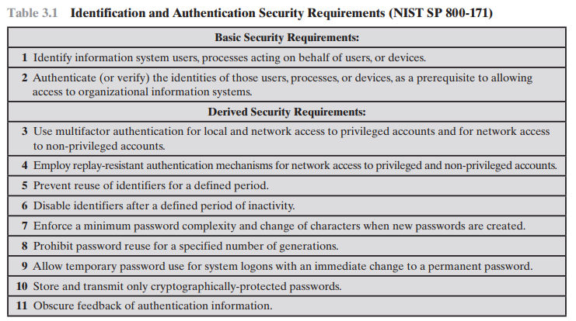

Slide 13
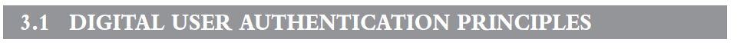
NIST SP 800-63-3 (Digital Authentication Guideline, October 2016) defines digital user authentication as the process of establishing confidence in user identities that are presented electronically to an information system.
Systems can use the authenticated identity to determine if the authenticated individual is authorized to perform particular function such as database transactions or access to system resources.

Slide 14
A Model for Digital User Authentication
The NIST SP 800-63-2 model
The initial requirement for performing user authentication is that the user must be registered with the system.
An applicant applies to a registration authority (RA) to become a subscriber of a credential service provider (CSP).
RA is a trusted entity that establishes and vouches for the identity of an applicant to a CSP.
The CSP then engages in an exchange with the subscriber. The CSP issues some sort of electronic credential to the subscriber. The credential (a data structure) binds an identity to a token possessed by the subscriber
The party to be authenticated is called a claimant
The party verifying that identity is called a verifier
The verifier passes on an assertion about the identity of the subscriber to the relying party (RP).
The RP can use the authenticated information provided by the verifier to make access control or authorization decisions.

Slide 15
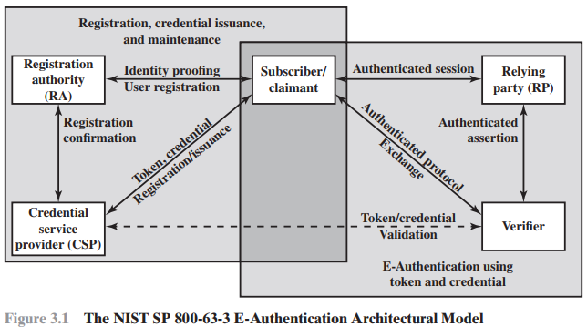

Slide 16
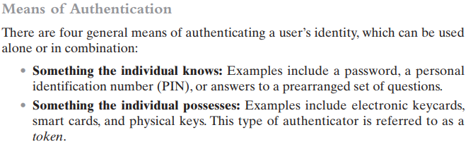

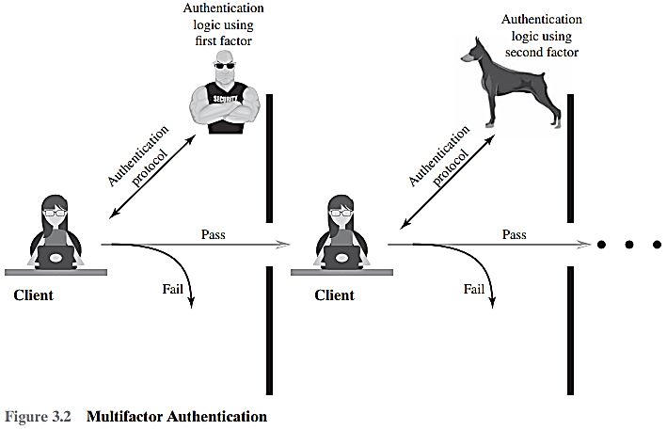
Multifactor authentication refers to the use of more than one of the authentication means in the preceding list. Implementations that use two factors are considered to be stronger than those that use only one factor; systems that incorporate three factors are stronger than systems that only incorporate two of the factors, and so on.

